Slide 1
MISMO Interactive Life of Loan Quick Reference Guide
January 2023

Slide 2
©2023 The Mortgage Industry Standards Maintenance Organization. All rights reserved.
AUTHORIZED USAGE: This MISMO Product (as defined in MISMO’s 2018 Intellectual Property Rights Policy) is in a DRAFT status and usage is restricted to MISMO members and workgroup Participants (as defined in MISMO’s 2018 Intellectual Property Rights Policy) solely for the purpose of advancing development of this MISMO Product. Access by non-MISMO members who are not Participants is not authorized without written express consent from a member of MISMO Staff. If such access is authorized, non-MISMO members who are not Participants will then be subject to the limited usage terms stated here. For a current list of MISMO members see http://www.mismo.org/x141284. Any other use of this MISMO Product, including implementation, is prohibited at this time.
PATENT DISCLOSURE REQUEST. MISMO requests that organizations, person, or entities given access to this MISMO Product in DRAFT status provide in writing any patent and or patent applications or other intellectual property rights that might be infringed by an organization that uses or is compliant with this proposed MISMO Product. These disclosures can be sent to info@mismo.org at any time. Use of the IPR Disclosure Form is recommended. A separate and formal request for Participant patent disclosures under MISMO’s 2018 Intellectual Property Rights Policy will be made at the time of publication of this MISMO Product.
PATENT DISCLAIMER. Attention is drawn to the possibility that some of the elements of this proposed MISMO Product may be the subject of third party patent rights. MISMO will not be held responsible for identifying any or all such patent rights.
MISMO’s 2018 Intellectual Property Rights Policy
https://www.mismo.org/about-MISMO/policies-and-procedures/2018-mismo-intellectual-property-rights-policy-document-and-excerpts/mismo-product-distributor-license-disclaimer
MISMO Product Distributor License
https://www.mismo.org/about-MISMO/policies-and-procedures/2018-mismo-intellectual-property-rights-policy-document-and-excerpts/mismo-product-distributor-license-v-1-0
Distributor Required Legal Notices
https://www.mismo.org/about-MISMO/policies-and-procedures/2018-mismo-intellectual-property-rights-policy-document-and-excerpts/mismo-product-distributor-license-required-legal-notices
MISMO Product User
https://www.mismo.org/get-involved/register-as-a-mismo-product-user
MISMO Product Distributor License Disclaimer
https://www.mismo.org/about-MISMO/policies-and-procedures/2018-mismo-intellectual-property-rights-policy-document-and-excerpts/mismo-product-distributor-license-disclaimer

Slide 3
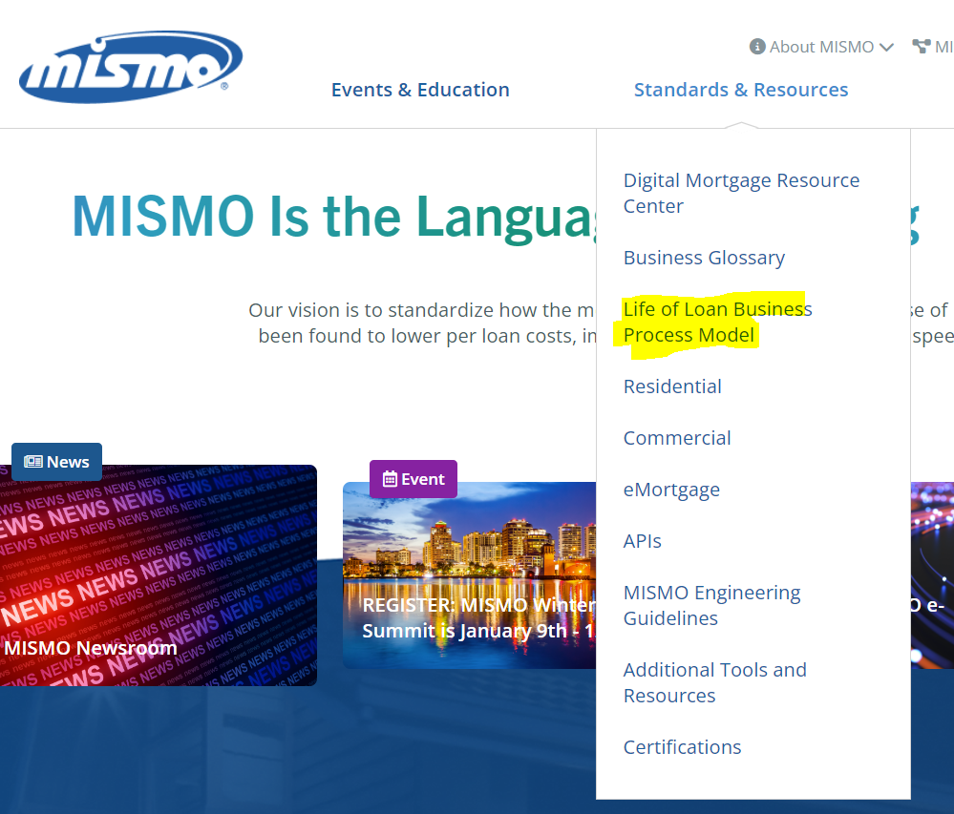
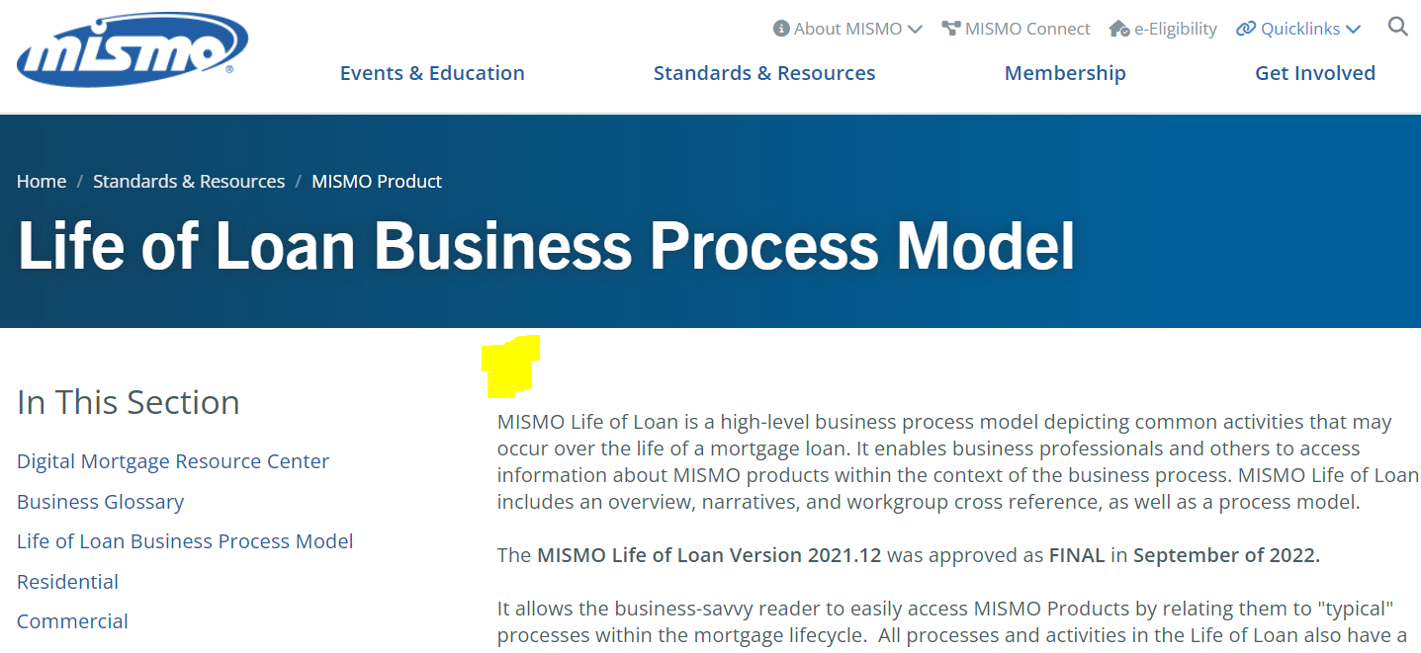
Accessing the Interactive MISMO Life of Loan
1
The Interactive MISMO Life of is accessed on www.MISMO.org
Select Standards & Resources from the navigation bar and click on Life of Loan Business Process Model to view the MISMO Life of Loan page
2
The link to the Interactive MISMO Life of Loan can be found at the top of the page.
Adoption Matters. Engage. Prepare. Support.

Slide 4
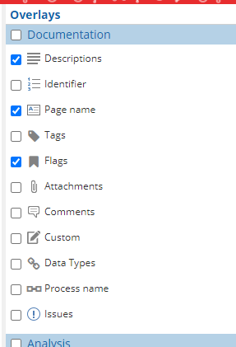
Interactive MISMO Life of Loan Main Page and Setup
1
There are three primary sections:
Origination
Servicing
Supporting Processes
Before you start clicking go to the next step to update settings
2
When accessing for the first time, update the Settings by clicking on the Flag to ensure the correct overlays are checked:
Description
Page Name
Flags

Slide 5
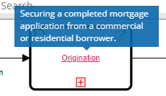
Navigating the Interactive MISMO Life of Loan
Move forward and backward from page to page
Use ‘X’ NOT Back Arrow
View the Business Glossary Definition
If the process name is red, there is a Business Glossary definition, hover over the red text to preview the Business Glossary definition.

Slide 6
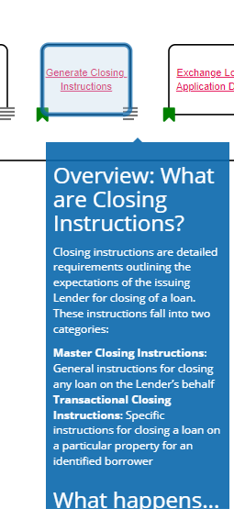
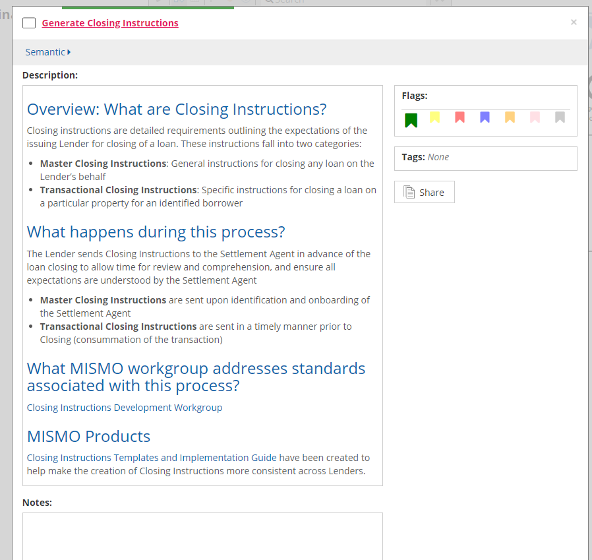
Navigating the Interactive MISMO Life of Loan
If there is an ellipses, there is a narrative.
Click on the ellipses to view the Narrative. Click on the red text to view the detail.

Slide 7
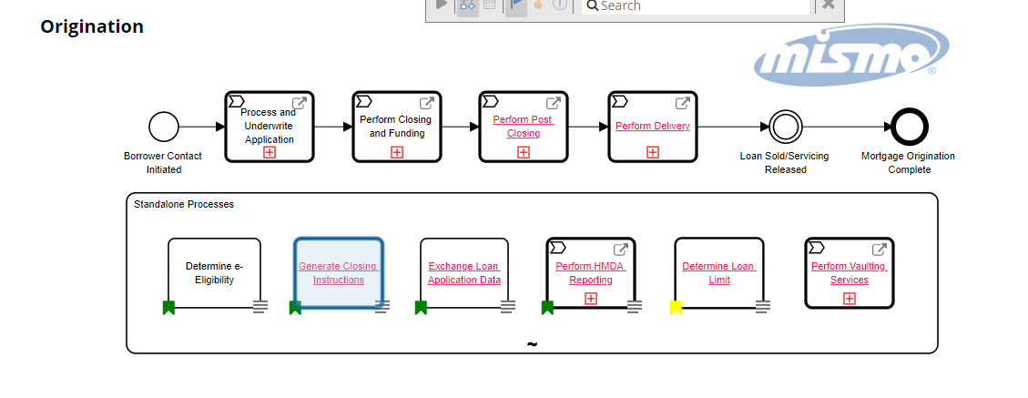
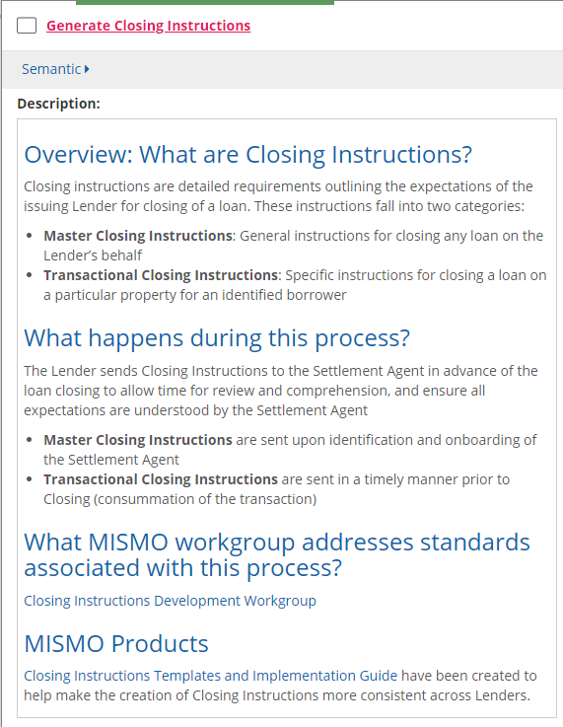
Navigating the Interactive MISMO Life of Loan
How to View Narratives
Click on the hyperlink for the process.
If there is no hyperlink, there is no narrative.

Slide 8
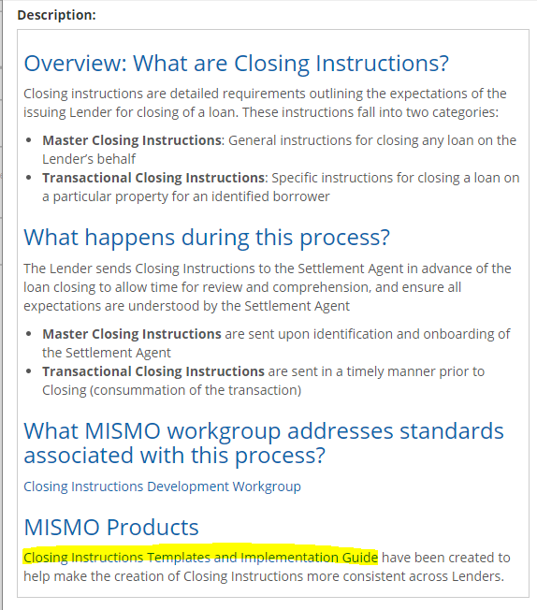
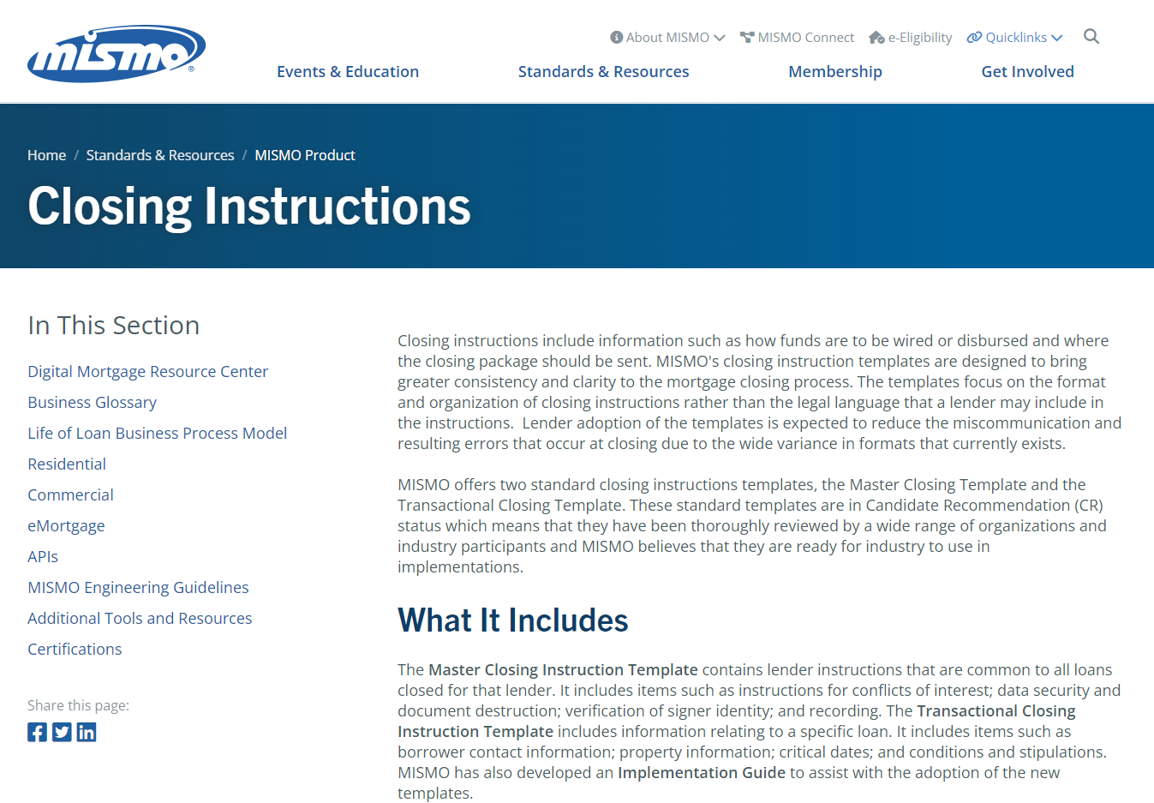
Navigating the Interactive MISMO Life of Loan
Additional Content in the Narrative
If there is content with a hyperlink, click on the hyperlink to view the reference content.

