Slide 1
MBA EVENTS APP QUICK SETUP AND HOW TO USE GUIDE

Slide 2
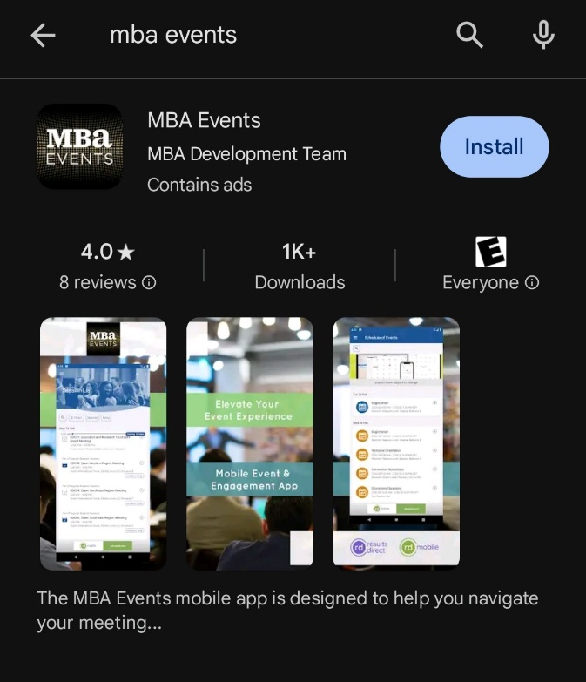
INTRODUCTION / INSTALLATION
The MBA Events Mobile App is designed to help you navigate your meeting experience. Use the app to:
Check into presentations and workgroup sessions
Create your custom schedule
View session and speaker information
Receive alerts/notifications
Download the app once and access all MBA events in one convenient location!
To download, open the app store on your phone and search for “MBA Events”. The app should have the same identifying information as you see in the image on the right.
Select “Install”

Slide 3
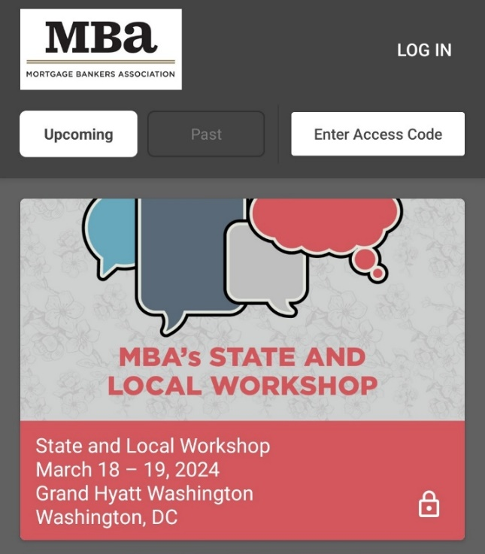
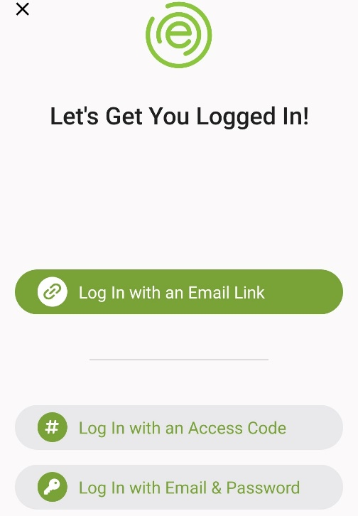
SIGN-UP PART 1
1. Open the app, and press “LOG IN” in the top right.
2. To sign up, press “Log in with an Email Link”.
If you already have an account, you can log in with any option.

Slide 4
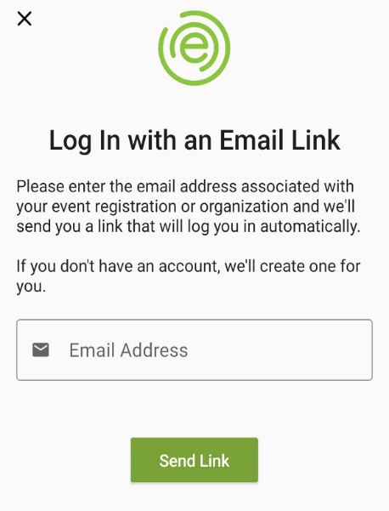
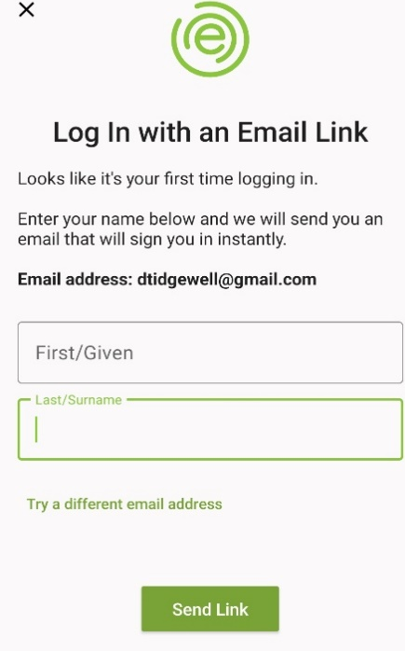
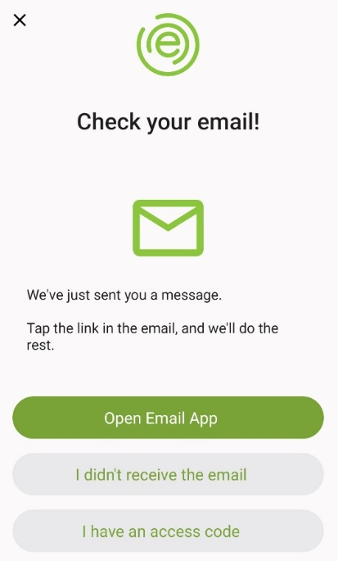
SIGN-UP PART 2
3a. Enter your email address* and then select “Send Link”.
3b. Enter your first / last name then select “Send Link”.
3c. You will receive this confirmation message:
*Please use the email address you use to log into MISMO Connect. You may use another email and associate your MISMO Connect email in the settings if you prefer.

Slide 5
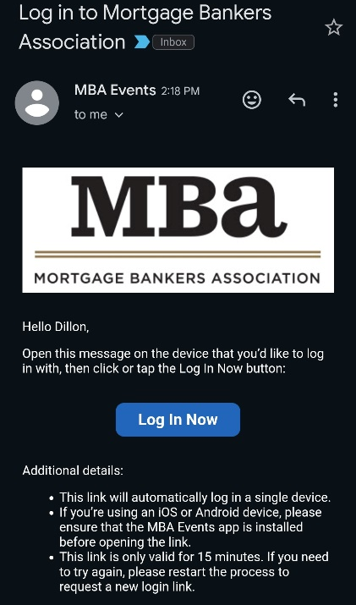
SIGN-UP PART 3
5. Check your email (easiest by phone) for a message that looks like the one below.
Select “Log In Now”.

Slide 6
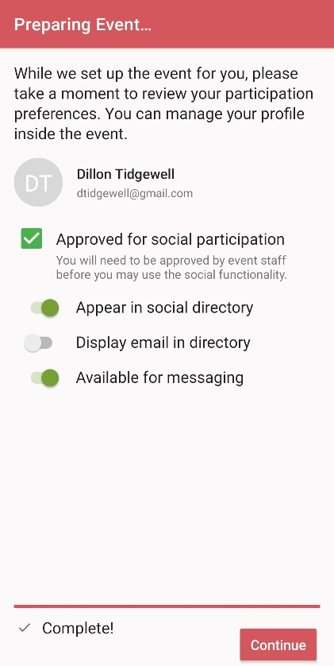
EVENT ACCESS
After logging in, to select an upcoming event that you have registered for, on the detail screen for that event, select “Select Event”
2. After the app confirms that you have registered for the event you have selected, you can select “Continue” to continue to the event.

Slide 7
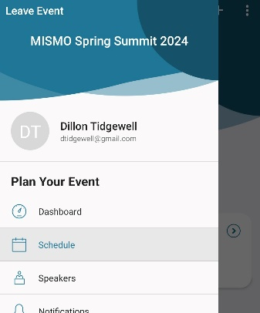
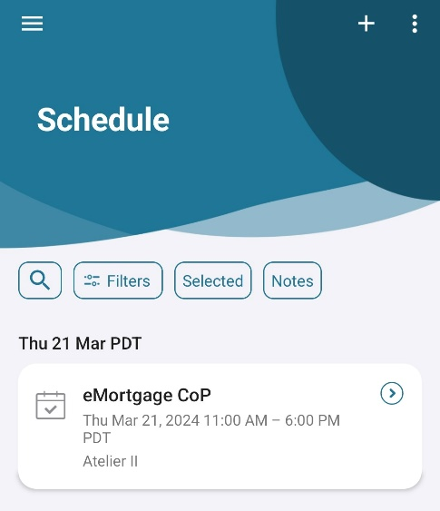
CHECKING IN TO A SESSION PART 1
1. Opening an event brings you to the event Dashboard. Press the icon in the top left to open the menu.
2. From the menu, select “Schedule”
3. From the Schedule screen, select the Session you would like to check into.*
*You may only sign into sessions while they are going on or 15 minutes prior to the start of the event.

Slide 8
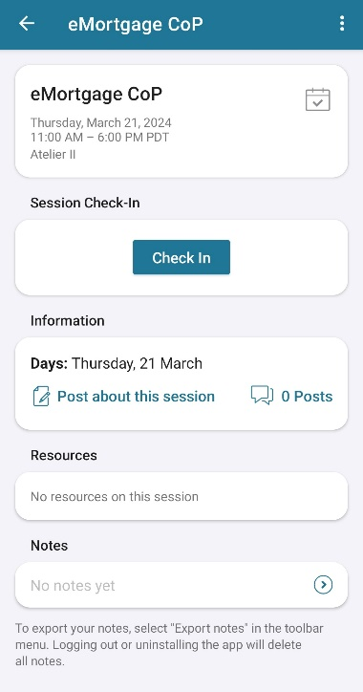
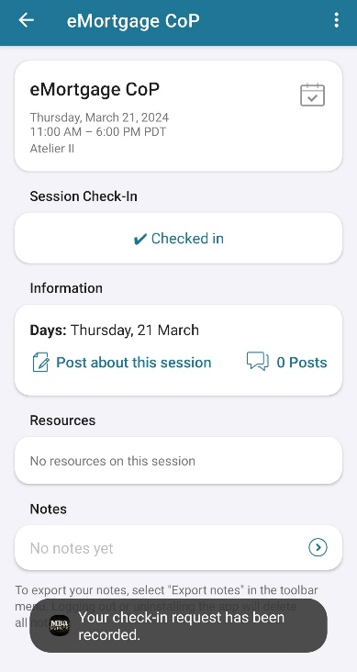
CHECKING IN TO A SESSION PART 2
1. After selecting a session, selecting the “Check In” button.
2. You will receive a confirmation notification and your status will display as “Checked In”.

